Slide 1
Organizing, Entrepreneuring, and Reengineering
Session 12

Slide 2
Definition of Organizing
Organizing is the function of management which follows planning. It is a function in which the synchronization and combination of human, physical and financial resources takes place.
According to Chester Barnard, “Organizing is a function by which the concern is able to define the positions, the jobs related and the co-ordination between authority and responsibility”. Hence, a manager always has to organize in order to get results.

Slide 3
A manager performs organizing function with the help of following steps:
Identification of activities
Departmentally organizing the activities
Classifying the authority
The provision for co-ordination horizontally and vertically

Slide 4
Organization: A formalized intentional structure of roles or positions.
Intentional structure of roles mean?
people working together must fill certain roles
The roles people are asked to fill should be intentionally designed to ensure that required activities are done and that activities fit together so that people can work smoothly, effectively and efficiently in groups.

Slide 5
Formal Organization
The intentional structure of roles in a formally organized enterprise.

Slide 6
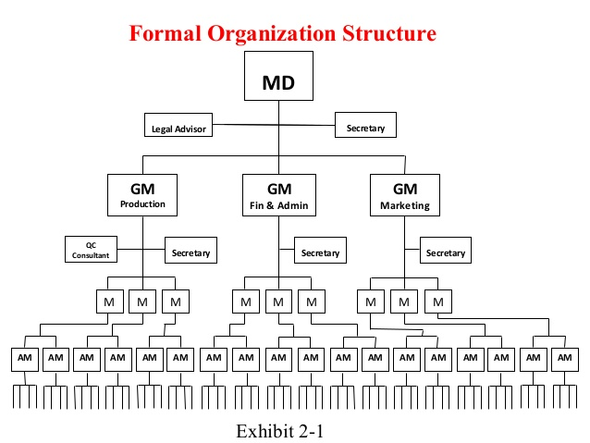

Slide 7
Informal organization
A network of interpersonal relationships that arise when people associate with each other.

Slide 8
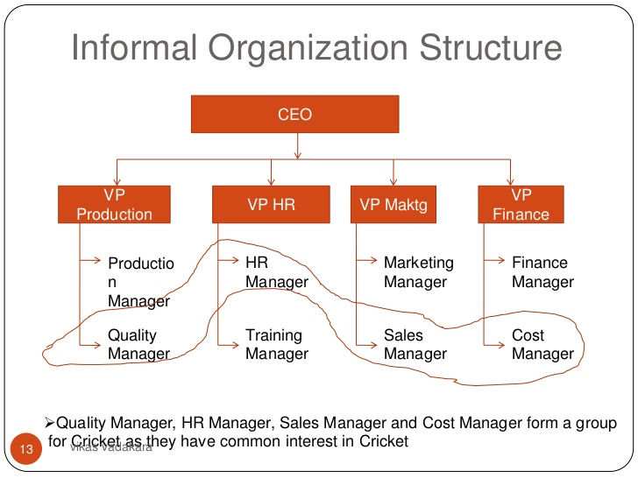

Slide 9
Organizational Division-The department
Specialized functional area within an organization or a division, such as accounting, marketing, planning. Generally every department has its own manager and chain of command.

Slide 10
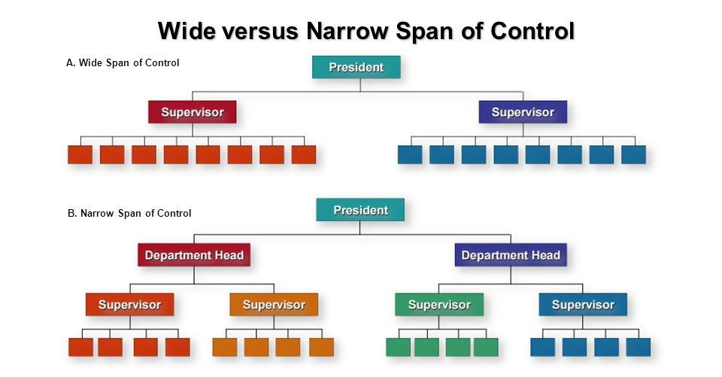
Organizational levels and the Span of management

Slide 11
Advantages of narrow span
Close relationships between workers and employees
Close supervision of employee tasks
Possibility for more upward growth for employees
Possibility for greater complexity of tasks for employees

Slide 12
Disadvantages of narrow span
Greater levels of management means greater operational costs
Tall organization with many layers of management means less efficient communication upward and less interest in communication downward
Lessening of employee morale and feelings of belonging
Lower skilled, less motivated employees require more supervision

Slide 13
Advantages of wide span
Superiors are forced to delegate
Clear policies must be made
Subordinates must be carefully selected

Slide 14
Disadvantages of wide span
Tendency of overloaded superiors
Danger of superiors loss of control
Requires exceptional quality of managers

Slide 15
Principle of the span of management
There is a limit to the number of subordinates a manager can effectively supervise, but the exact number will depend on the impact of underlying factors.

Slide 16
Width of span is affected by:
Skills and abilities of the manager and the employees
Characteristics of the work being done
Similarity of tasks
Complexity of tasks
Physical proximity of subordinates
Standardization of tasks
Sophistication of the organization’s information system
Strength of the organization’s culture
Preferred style of the manager .

Slide 17
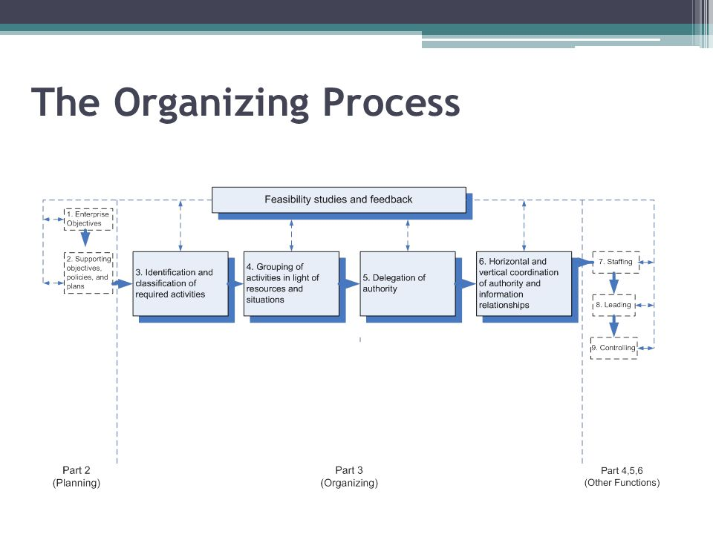

Slide 18
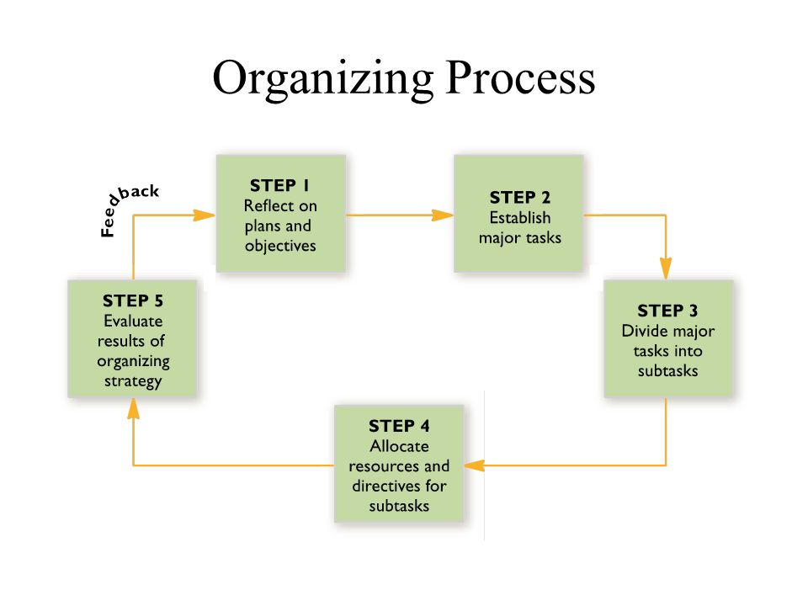

Slide 19
The Intrapreneur
A person who focuses on innovation and creativity and who transforms a dream or an idea into a profitable venture by operating within an established organizational environment.

Slide 20
Examples of Intrapreneurship
1. SONY
It might be the best-selling console in the world today, but Sony’s PlayStation only happened because a junior employee tinkered with his daughter’s Nintendo.
Ken Kutaragi spent hours trying to make the console more powerful and user-friendly but his idea was reportedly rebuffed by many Sony bosses – hesitant at joining a gaming industry they considered a waste of time. One senior employee spotted value in Kutaragi’s innovative product and the rest, as they say, is history.
2. FACEBOOK
One of the most documented initiatives associated with the rise of the social-networking behemoth has been its infamous “hack-a-thons”; all-night competitions for coders and engineers to develop an idea into a prototype. Facebook’s ‘Like’ button was born from the event, and has since become synonymous with the brand.

Slide 21
The Entrepreneur
A person who does similar things as the Intrapreneur, but outside the organizational setting.
Examples: Steve jobs, Walt disney, Mark Zuckerberg, Jeff Bezos.

Slide 22
Creating an environment for Entrepreneurship
It is managerial responsibility to create an environment for effective and efficient achievement of group goals, managers must promote opportunities for entrepreneurs to utilize their potential for innovation.

Slide 23
Reengineering the organization
Organizational reengineering is a technique used to redesign business processes in order to take advantage of organizational strengths, called core competencies. Using this technique, an organization can align itself for the future and increase its market share and profitability.

Slide 24
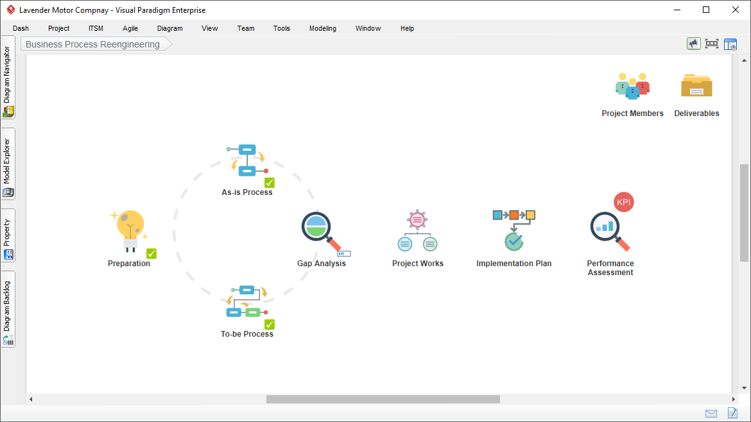

Slide 25
Examples of reengineering:
Bank of India
Mahindra
ICICI Bank

Slide 26
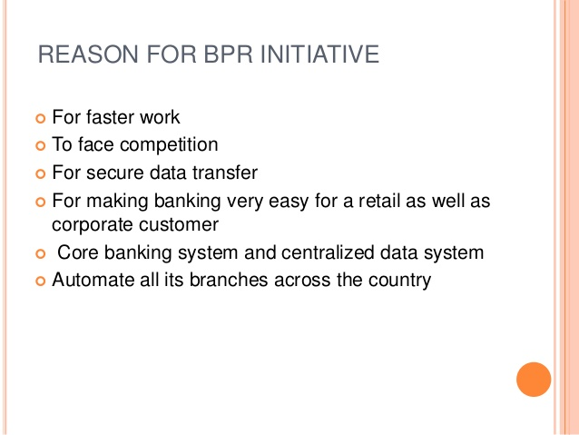
Bank of India

Slide 27
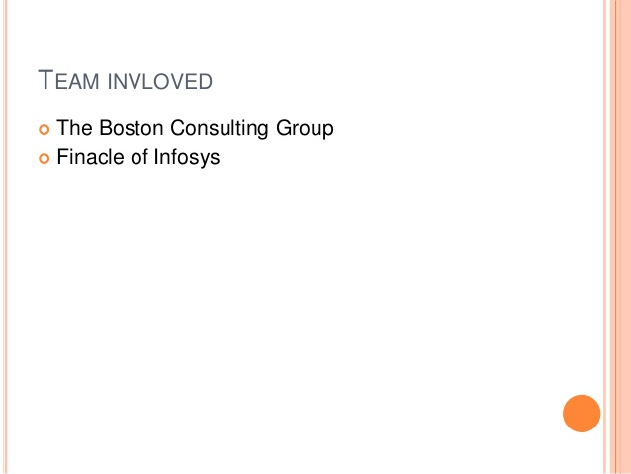

Slide 28
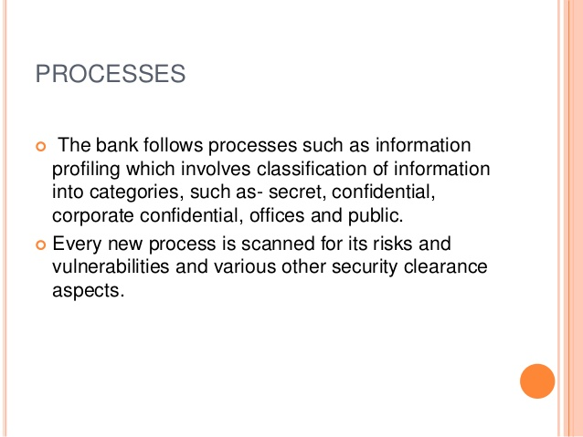

Slide 29
